Slide 1
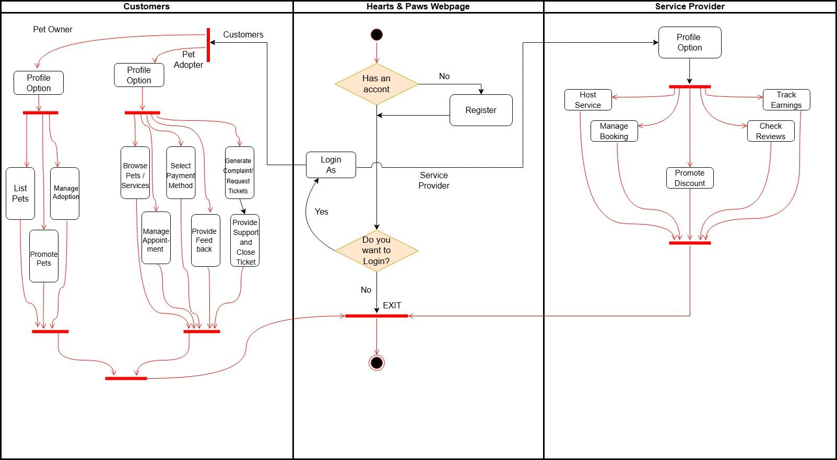
Activity Diagram- Hearts & Paws

